Slide 1
Particles and Pathogens
Rocks, leaves, branches, fish, frogs, sand, grit, clay, and pathogens
In which pathogens are removed because they are particles

Slide 2
Big picture of water treatment
Water Source
Possible Unit Processes
Contaminants
Select Unit Processes
Disinfection Complications
Regulations
Sequence the unit processes
Client needs
Distribution Complications

Slide 3
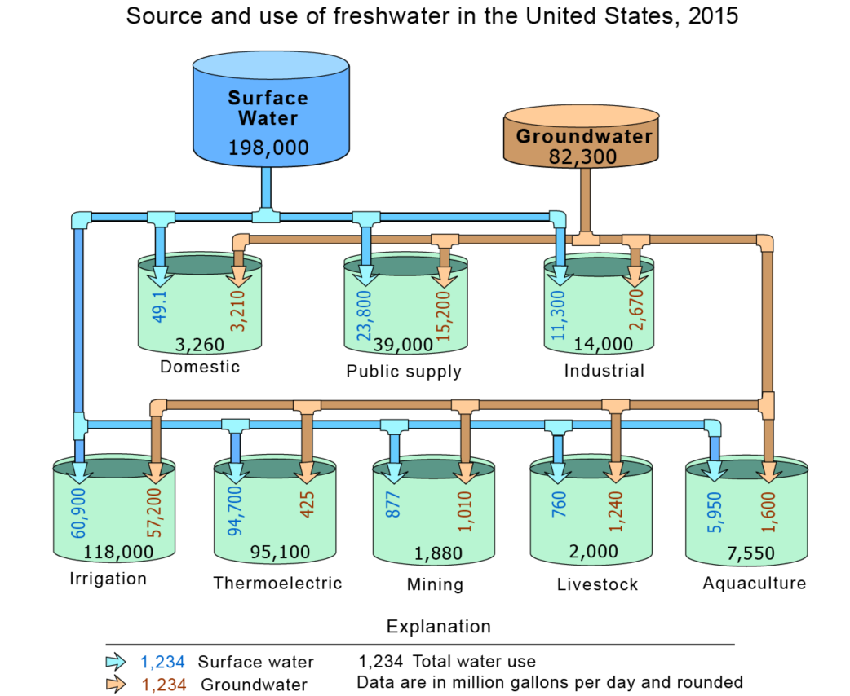
Water sources
https://www.usgs.gov/special-topic/water-science-school/science/groundwater-use-united-states?qt-science_center_objects=0#qt-science_center_objects

Slide 4
Conventional Water Treatment Processes (focus on particles and pathogens*)
Screening, Coagulation, Flocculation (Chapter 9)
Sedimentation (Chapter 10)
Granular Filtration (chapter 11)
Membrane Filtration (Chapter 12)
Disinfection (Chapter 13)
*Happily these processes can also remove some dissolved contaminants too!

Slide 5
Conventional Surface Water Treatment
Raw water
Screening, grit removal, flow measurement
Rapid Sand Dual
Media Filtration
sludge
Backwash water
Coagulant
Mechanical Rapid Mix
Cl₂
Disinfection
Mechanical Flocculation
Storage
Sedimentation
Distribution
sludge

Slide 6
AguaClara Surface Water Treatment
Raw water
Screening, grit removal, flow measurement
Stacked Rapid
Sand Filtration
Coagulant
sludge
Backwash water
Cl₂
Hydraulic
Flocculation
Storage
Floc Blanket
Distribution
Floc Hopper
Plate Settlers
sludge

Slide 7
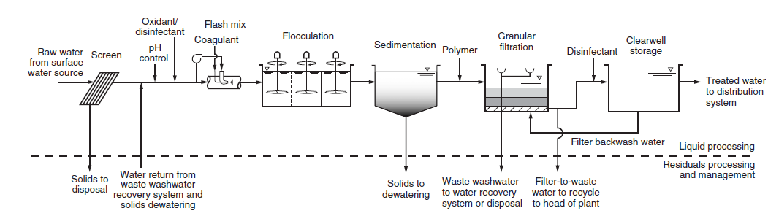
Conventional Floc/sed/rapid sand used to treat turbidity > 10 NTU
MWH’s Water Treatment: Principles and Design, Third Edition
John C. Crittenden, R. Rhodes Trussell, David W. Hand, Kerry J. Howe and George Tchobanoglous
Copyright © 2012 John Wiley & Sons, Inc.

Slide 8
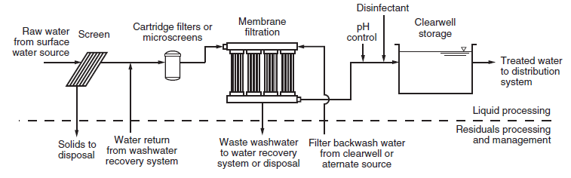
Membrane filtration for <10 NTU
MWH’s Water Treatment: Principles and Design, Third Edition
John C. Crittenden, R. Rhodes Trussell, David W. Hand, Kerry J. Howe and George Tchobanoglous
Copyright © 2012 John Wiley & Sons, Inc.

Slide 9
More options!

Slide 10
Jargon for Confusion in Env. Eng.
How to express velocities in units that confuse…
Surface loading rates (for sedimentation tanks)
Flux (for membrane filters)
Filtration velocities (for granular media)
A modest proposal
Let’s consistently use the simplest SI units so that we can compare across processes and bring physical insight
The standard unit of time is seconds
mm/s!
gpm/ft²
Lph/m²
m/hr

Slide 11

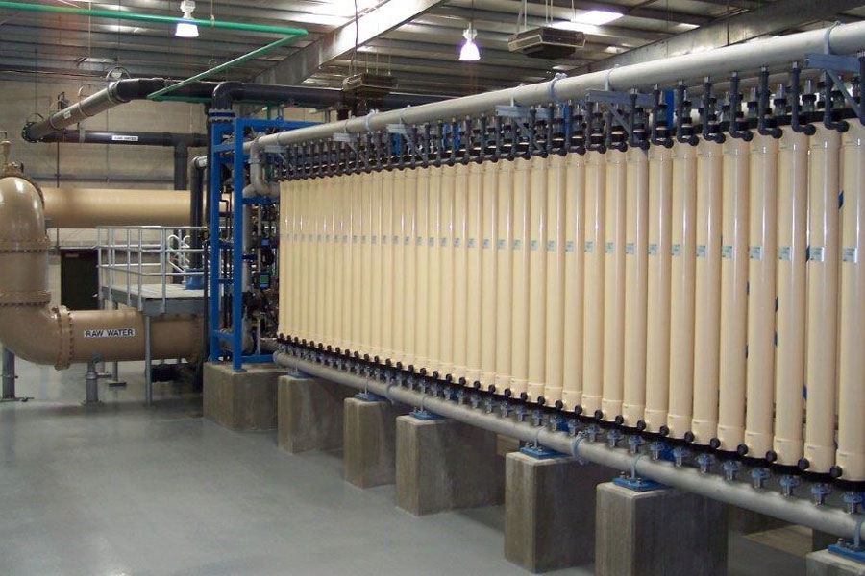


Guideline for choosing filtration technology
The decision to use granular filtration or membrane filtration in any particular facility depends on site-specific circumstances - (Page 826 in MWH Water Treatment)
Anthracite
Sand
Gravel

Slide 12
How would you compare granular filtration vs membranes?
Concentration of waste stream (and hence fraction of water that must be wasted)
Net velocity (and hence area required)
Useful life (membranes have relatively short lives)
Chemical requirements (membranes require chemical washes) and safe disposal
Capital costs
Membranes produce water with fewer particles! (and membrane integrity must be monitored)

Slide 13
Membrane Filtration at Ithaca Water Treatment Plant
4 mgd – 176 L/s completed Dec 2016
$37.5 million WTP upgrade ($214,000 per L/s)
Contrast with 120 L/s for $1 million in Gracias
Floc/sed/membranes/chlorine
Why was it expensive?
Higher labor costs
Staged construction to keep plant operating
Complexity – count of moving parts would be astounding
Who can explain the path of water through the plant?

Slide 14
Tour questions
When was the last time they changed the coagulant dose?
What prompted the change and how did they choose what the new dose would be?
How do they know if they should increase or decrease the coagulant dose in order to improve performance? What defines performance for them given that they have membrane filters?
What are examples of things that have required repair in the last year?
What is their favorite thing about working with this plant?

Slide 15
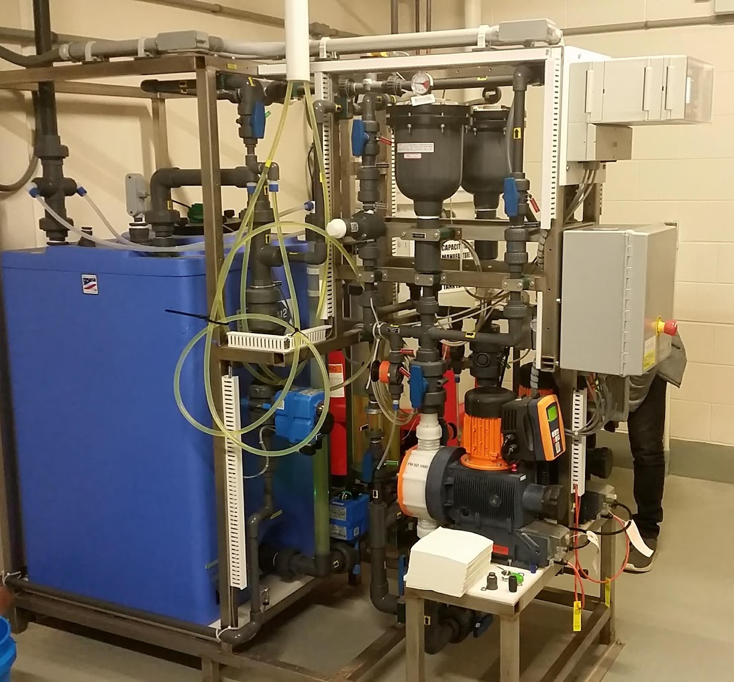
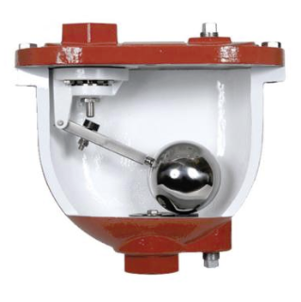
Chemical feed system
Notes:
Ithaca Water Treatment Plant – photo taken on 4/13/2019

Slide 16
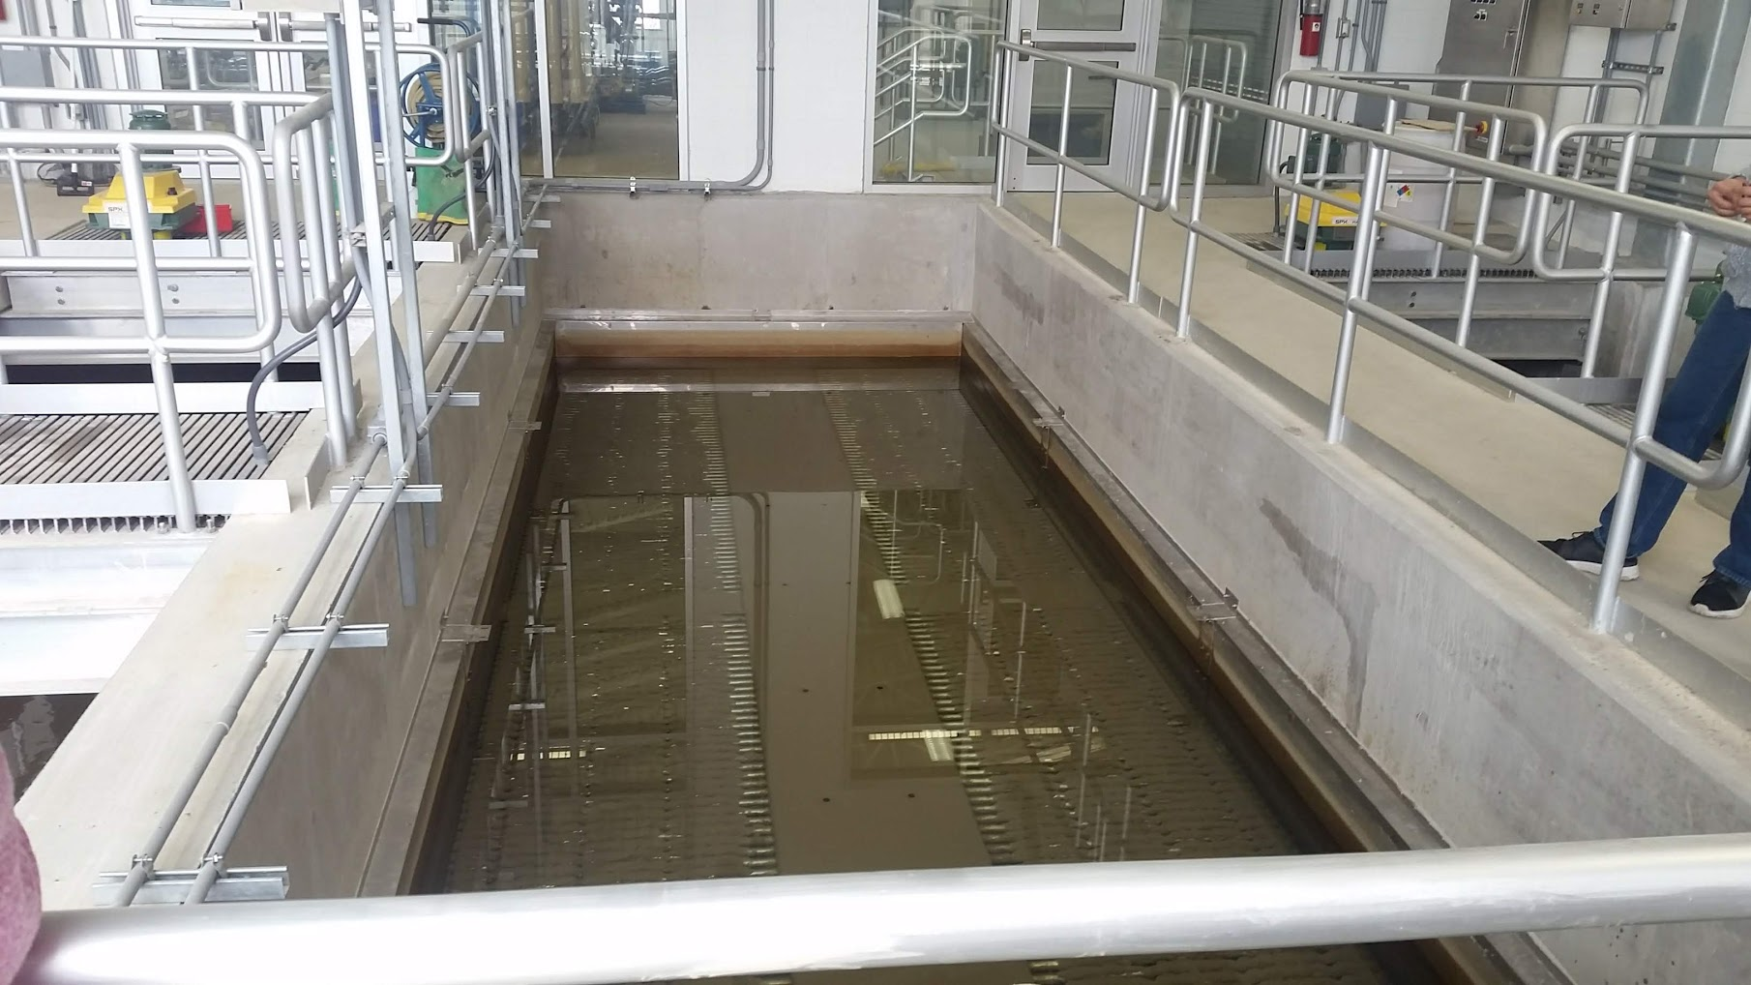
Sedimentation tank for 60 L/s Can you see the flocs???
How were the plates supposed to work?
http://www.meurerresearch.com
Notes:
Ithaca Water Treatment Plant – photo taken on 4/13/2019
Flight and chain mechanized cleaning
Plate setters with flow control!
4 mgd is treated by 3 sed tanks.

Slide 17
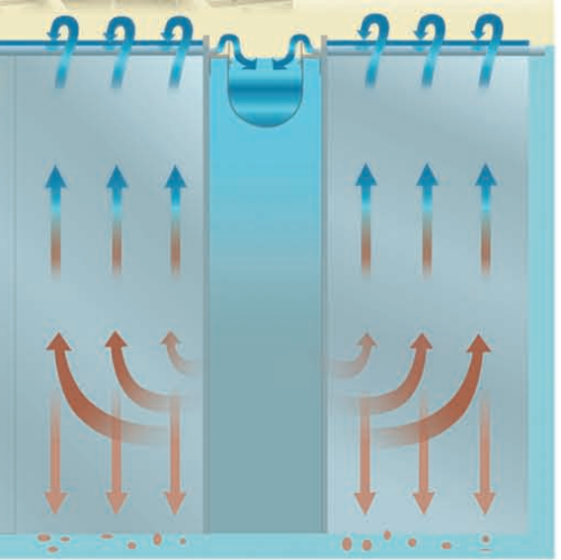
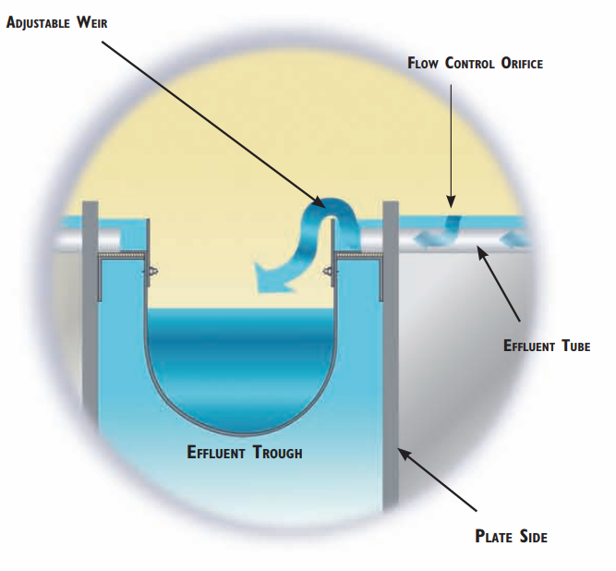
Plate settler hydraulics
How is it similar/different from AguaClara sed tanks?
How could you make it better?
How much can the water level rise in the sed tank?
Notes:
http://www.meurerresearch.com

Slide 18




AguaClara Sedimentation Tank
Dump poorly flocculated water channel
Exit Weir that controls water levels all the way upstream to the next free fall (LFOM!)
Notes:
Exercise: Tell the story of the journey of a large floc, a small floc, a rouge loner clay particle, and of a water molecule as each travels through this sedimentation tank.
How do plate settlers work

Slide 19
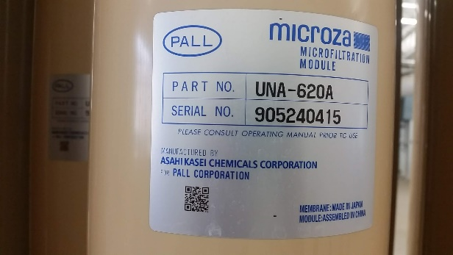
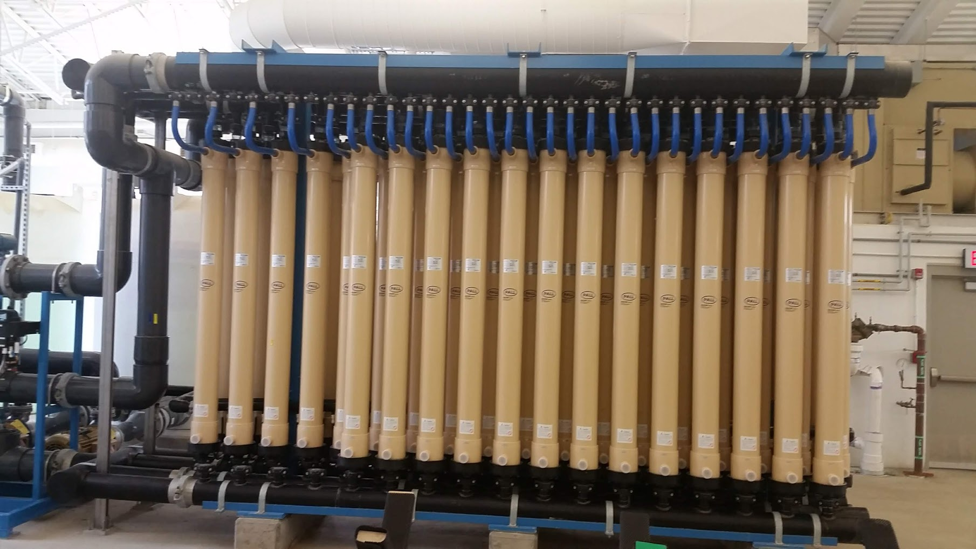
66 membrane modules to filter 44 L/s
Notes:
Ithaca Water Treatment Plant – photo taken on 4/13/2019
1 mgd unit at Ithaca Water Treatment Plant
How much area would a StaRS filter take?

Slide 20
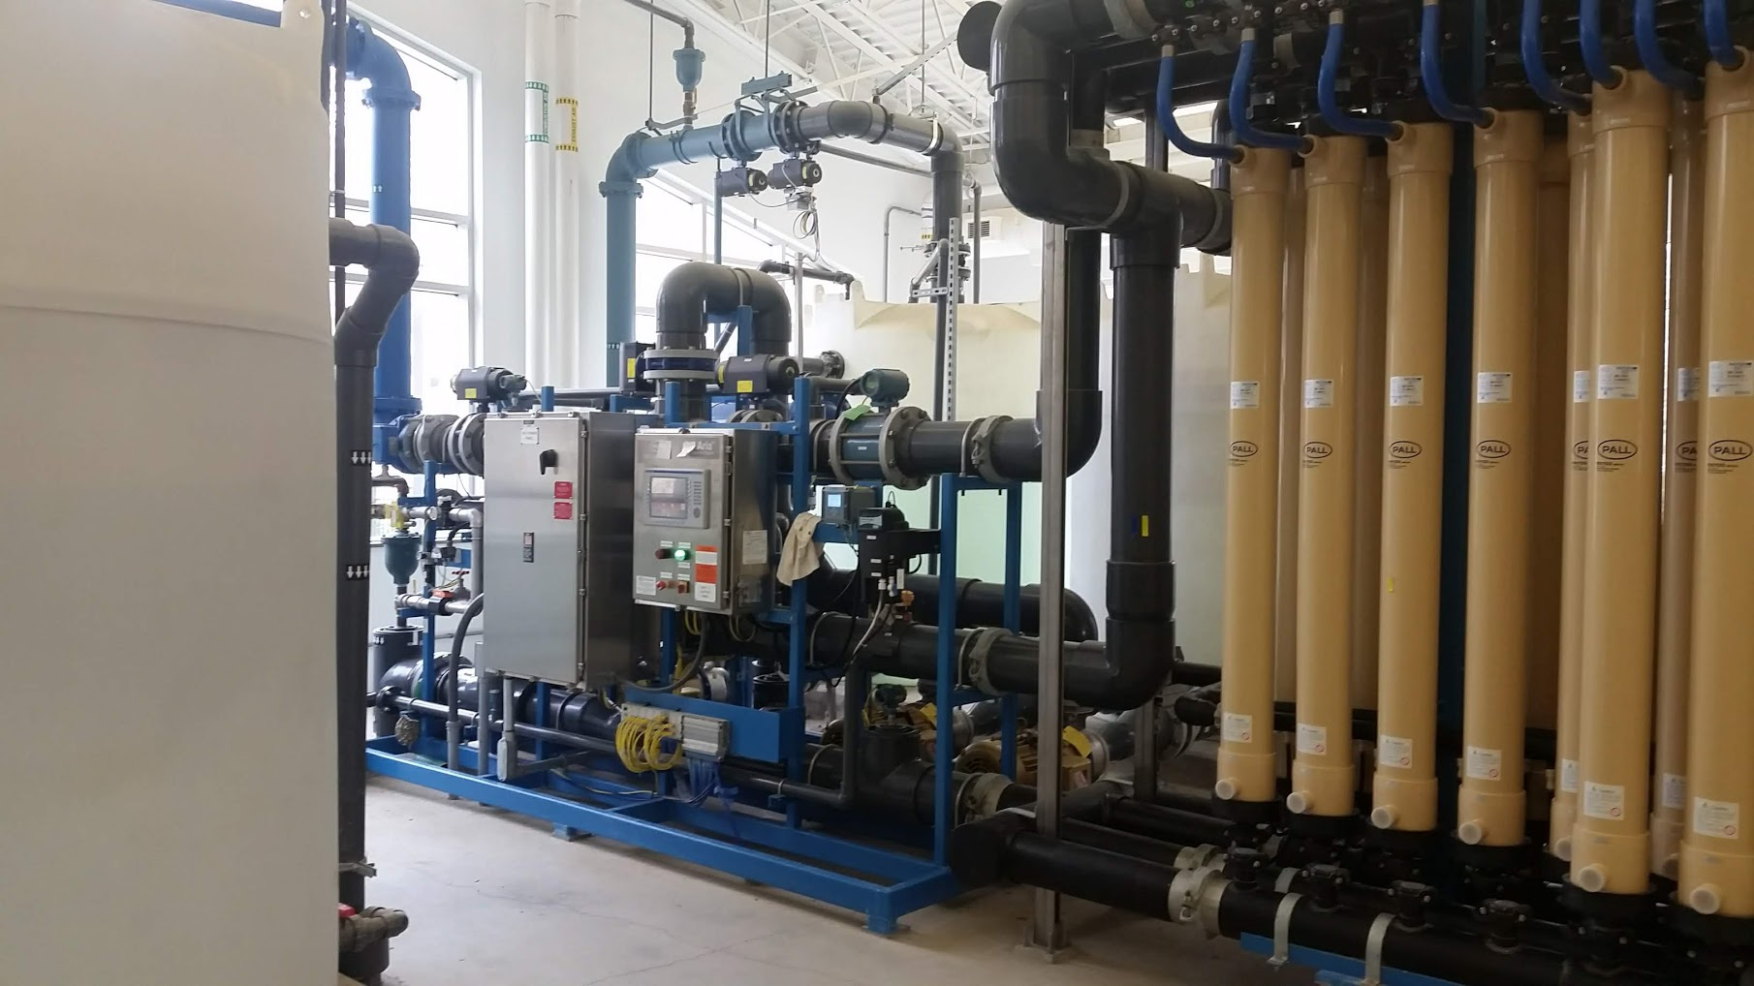
Pumps and controls for membranes
Notes:
Ithaca Water Treatment Plant – photo taken on 4/13/2019
All filters require extra space for controls

Slide 21
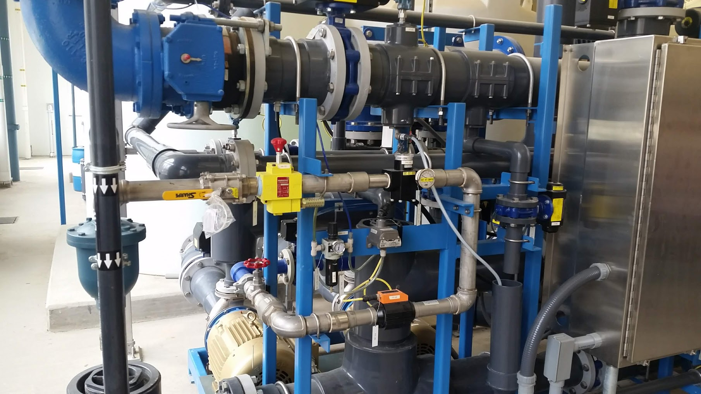
Valves, Pumps, Flow Meters, Air Release
Notes:
Ithaca Water Treatment Plant – photo taken on 4/13/2019

Slide 22
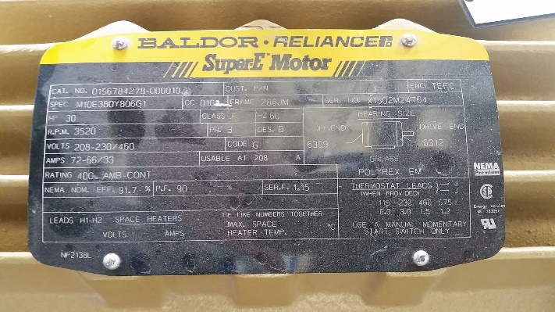
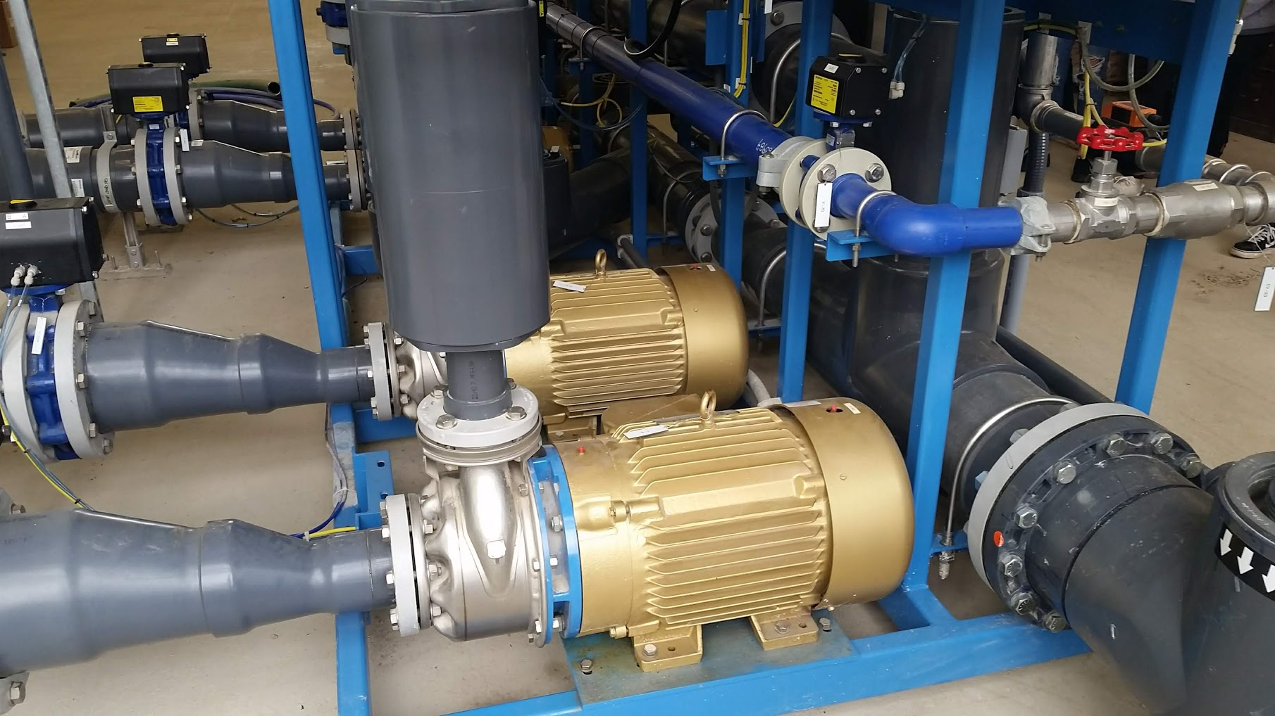
4 30 Hp pumps
Notes:
Ithaca Water Treatment Plant – photo taken on 4/13/2019

Slide 23
Resilient Infrastructure
Contrast Cornell and Ithaca water treatment
Our goal is a long time between component failures
Moving parts and electrical contacts have short lives
Automation systems that continually move valves will cause early failure of those valves
The system should be understandable
Complexity vs elegance!

Slide 24
More questions for the Tour?
How is the sludge removed from the sed tanks?

Slide 25

Filters with two completely different particle capture mechanisms
Rapid Sand Filters (Depth filters)
Mechanism: flow contraction at sharp edge (made of previously deposited particles) where the boundary layer has not yet developed
Pores are at capacity when fluid shear matches coagulant bond strength (many particles per pore and many pores per depth of filter
Membrane Filters (Surface filters)
Mechanism: size exclusion
Particle deposits on top of the pore (1 particle per pore)
Anthracite
Sand
Gravel

Slide 26
Rapid Sand Filter (Conventional US Treatment)
Size
(mm)
0.70
0.45 - 0.55
5 - 60
Specific
Gravity
1.6
2.65
2.65
Depth
(cm)
30
45
45
Anthracite
Influent
Sand
Gravel
Drain
Effluent
Wash water

Slide 27
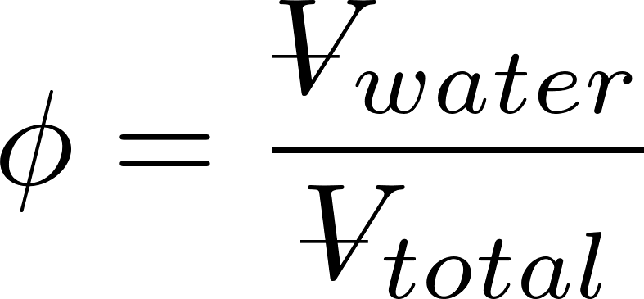
Rapid Sand Filter Design
Filter media
silica sand and anthracite coal
non-uniform media will stratify with _______ particles at the top
Filtration approach velocities
0.7 – 2.8 mm/s
Backwash approach velocities
set to obtain a bed porosity, φ, of 0.65 to 0.70
Fluidized bed
smaller
Does water speed up or slow down when it enters the sand?
Similar in size to AguaClara Sed (1 mm/s)

Slide 28
Backwash (Fluidized Bed)
Wash water is treated water!
WHY?
Anthracite
Sand
Only clean water should ever be on effluent side of filter!
Influent
Gravel
Drain
Effluent
Wash water
Notes:
https://www.youtube.com/watch?v=9tqk2cFDi5o#t=226

Slide 29
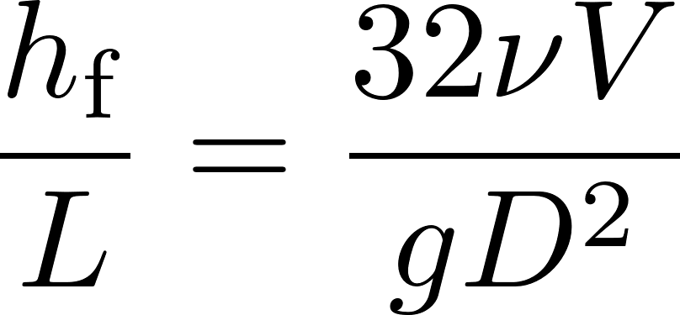
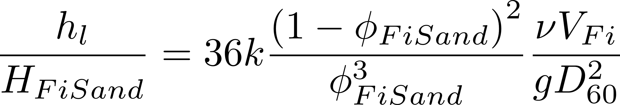
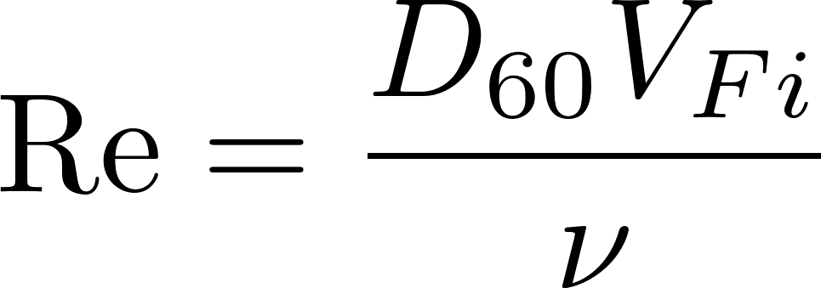
Clean Bed Head Loss (Karmen Kozeny)
Hagen Poiseuille
Porosity (0.4 for uniform size media)
Kinematic viscosity
Approach velocity
Head loss
Sand diameter
Flow path length (filter bed depth)
Kozeny constant
Approximately 5 for most filtration conditions
Assumes laminar flow and is valid up to Re of 6
Notes:
Karmen Kozeny valid up to Re of 6
Page 8.10 in Water Quality and Treatment: A Handbook of Community Water Supplies. Fifth edition.
What happens if we have an upflow RSF and we gradually increase the filtration velocity? At some point (to be determined) the pressure difference will be enough to lift the entire sand bed!

Slide 30
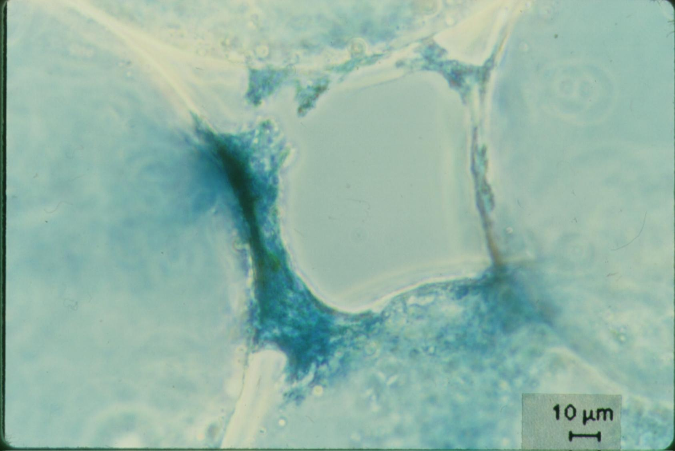
Interception occurs where streamlines converge
No removal by interception in straight tube
Particles are deposited at the constriction
The biggest part of the filter pore remains empty!
Big particles can’t attach to partially filled restrictions

Slide 31
Active filtration zone slowly moves down through the filter
Effluent Turbidity
NTU
Time

Slide 32
Active Filtration zone
Backwash debris
Active zone breakthrough
(large flocs likely get to the bottom of the filter first)
Loaded zone
Filtration improves while loaded zone expands and clean zone shrinks
Therefore particle removal is better in loaded zone than in clean zone!
Active Filtration zone
NTU
Clean zone
Time

Slide 33
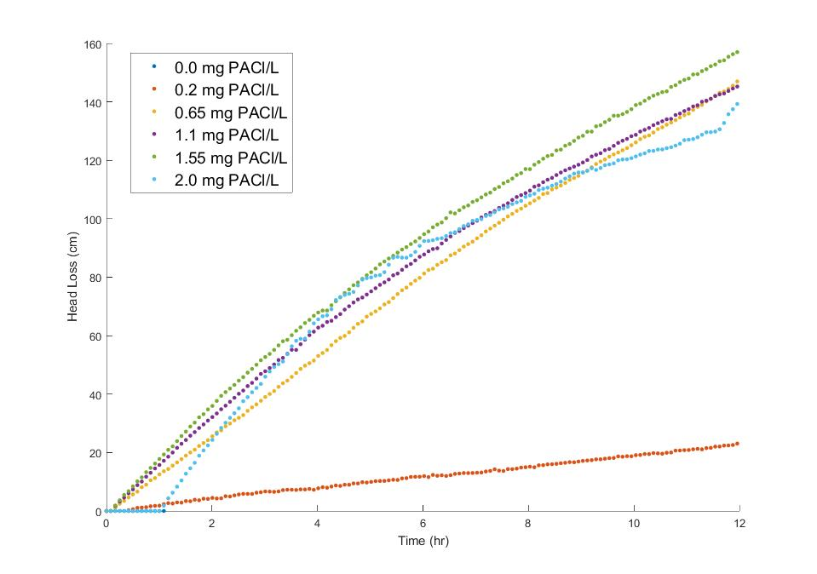
Head loss in Rapid Sand Filters is close to linear before breakthrough
The number of “full” pores that the water flows through increases linearly with time!
Each “full” pore contributes a little head loss
5 NTU of kaolin clay
0.65 mg/L
1.55 mg/L
Breakthrough
Notes:
With bigger flocs there is less head loss at breakthrough!
With bigger flocs there is more head loss per mass of particles removed

Slide 34
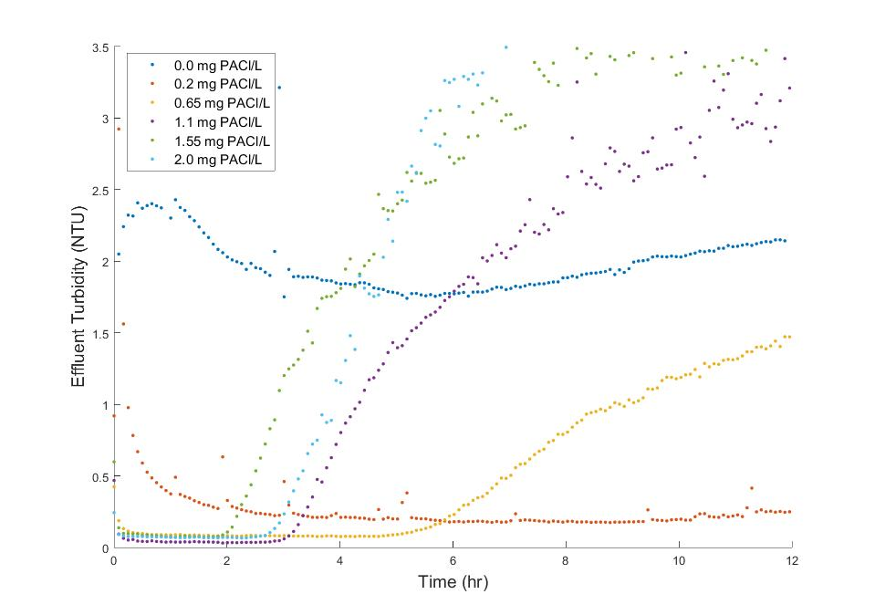
5 NTU of kaolin clay
Very steep failure
1.55 mg/L
0.65 mg/L
Lucinda Li, Theresa Chu, Jonathan Harris, Mythri Krishnamoorthysujatha, Rose Linehan, William H. Pennock

Slide 35
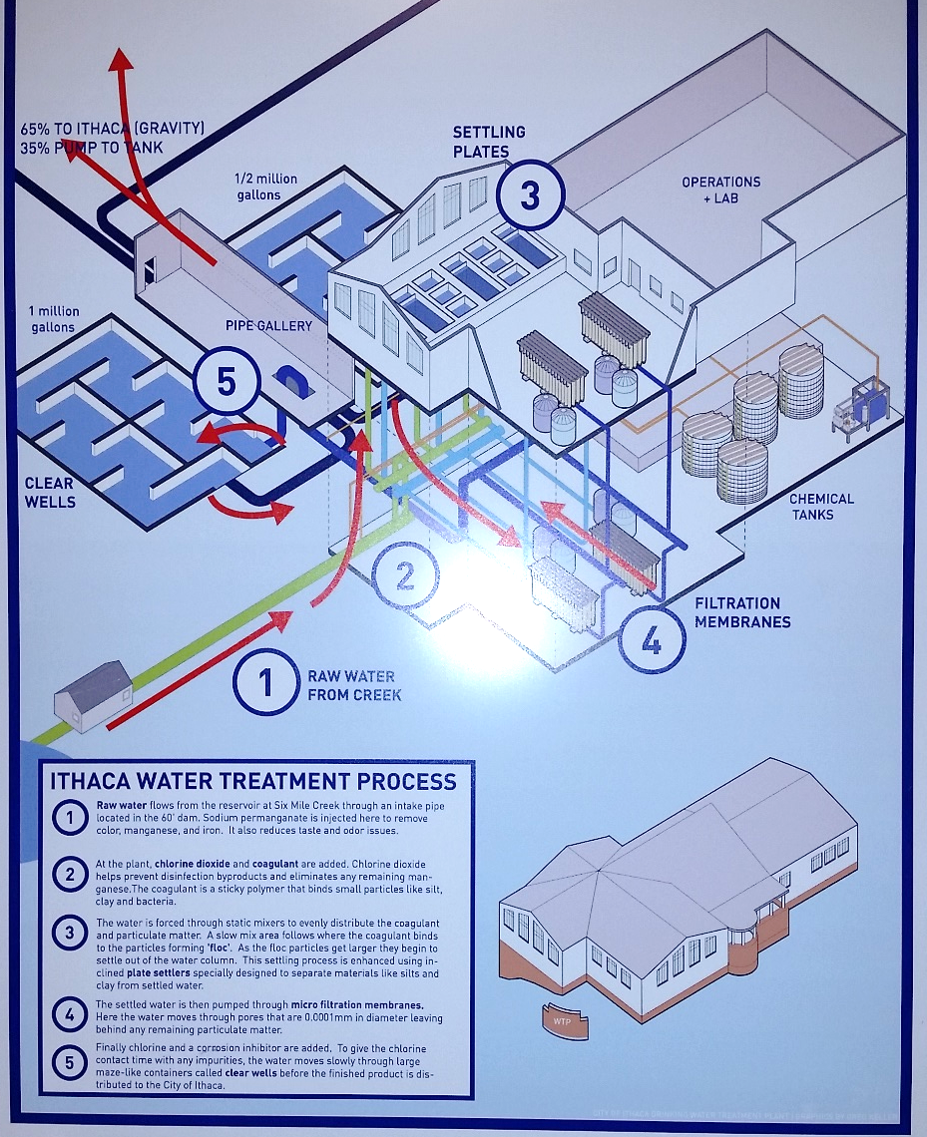
Reflections on the field trip to City of Ithaca WTP
Why membranes?
“Long life” – 10 years under ideal conditions
Better prepared for future treatment processes
More compact (not when accounting for extra tanks required)
Why might they require back pressure?
Similar filtered water turbidity to CUWFP
Plant complexity

Slide 36
Membrane Filtration
Notes:
$14,800,000
https://www.kpaengineers.com/portfolio-items/membrane-filtration-plant/
15 MGD
No pretreatment
$22500 /(L/s)
Actuually operates at 11.6 MGD
Project Description: The City of Temple, Texas owns and operates the 11.6 MGD Membrane Water Treatment Plant. The plant was placed into operation in 2004 and operated as originally designed for the first 12 to 15 months. However, over the past several years the plant has not been able to consistently operate at the design capacity. $590,524 to upgrade the chemical cleaning
Realized they needed pretreatment in 2008
Backwash Sedimentation $2,607,785

Slide 37
Membrane Filtration for Drinking Water Treatment: Topics
Removal by size exclusion
Size of contaminants
Head loss through a pore
Number of pores per area of membrane
Typical filtration approach velocities
How do they achieve reasonable flow rates per plan view area?
Low pressure and high pressure systems
Fouling (backwashing doesn’t fully clean the membranes)
Dissolved Organic Matter removal
Notes:
Brent Alspach
Membrane filtration is certainly carving out a substantive niche in drinking water treatment, but I wouldn’t say that they’re generally preferred; nor would I expect them to overtake the use of conventional treatment any time soon.
I’m not aware of any generalized comparison between media (rapid sand) filters and MF/UF, primarily due lots of variability with site-specific factors, the membrane product used, and system capacity, among others. The performance comparison should be pretty straightforward, but the relative costs and other issues (e.g., maintenance, automation, etc.) can be very different from site-to-site and client-to-client.
It might be better to simply stick to performance-based factors in teaching your class, and then noting the other items that are more subjective and can influence the selection of one technology over another. This would have more practical value for your students then some kind of a generalized comparison that is assumed (almost certainly erroneously) to be broadly applicable.
Membranes (and other advanced treatment technologies) are the same as more conventional processes, in which you’d do some calculations to size the system, based on theory described in texts. In practice, as an engineer, you really have to understand what the technology is capable of doing, along with its pros and cons, operational nuances, potential challenges, etc., and then if the technology is a good candidate for an application, you’d rely on the vendor to size the system. Alternatively, if possible within budget and scheduling constraints, you might also conduct a pilot test, which would give the engineer more direct information to specify design criteria. (Just to clarify – this is MF/UF; the paradigm is a bit different than NF/RO.)
There are some AWWA Manuals of Practice for both MF/UF and NF/RO, and those have some interesting information that might be of use. Those are all prepared by volunteers (i.e., people like us who donate our time and expertise) in the profession, so they tend to be more practical than theoretical.

Slide 38
Pore sizes of membranes
Particles, Sediment
Algae, Protozoa, Bacteria
Microfiltration
0.1 μm pores
Membrane filtration
Ultrafiltration
0.01 μm pores
Small colloids
Viruses
Nanofiltration
0.001 μm pores
Dissolved organic matter
Divalent ions (Ca²⁺, Mg²⁺)
Reverse Osmosis
Reverse osmosis
Nonporous
Monovalent species (Na⁺, Cl⁻)
Water

Slide 39
Parameter | Membrane Filtration | Reverse Osmosis | Rapid sand Filtration
Mechanism | Straining (size exclusion) | Differences in solubility or diffusivity | Flow constrictions
Removal efficiency | pC* of 6 (99.9999%) | 50% to 99% | ????
Transmembrane pressure | 0.2 - 1 bar | 5 – 85 bar
Transmembrane head loss | 2 – 10 m | 50 – 850 m | 2-3 m (0.2 – 0.8 m for StaRS)
Approach velocity* | 8 – 50 μm/s | 0.3 – 14 μm/s | 1.4 – 4.2 mm/s
Competing process | Rapid sand | Carbon adsorption, ion exchange, precipitative softening, distillation | membranes
Filter run time | 30 – 90 minutes |  | 1 – 4 days
Backwash duration | 1 – 3 minutes |  | 10-15 minutes
*not pore velocity
Notes:
Adapted from Crittenden, John C., and et al.. MWH's Water Treatment: Principles and Design, Third Edition. John Wiley & Sons. © 2012.Skillsoft. <https://proxy.library.cornell.edu/sso/skillport?context=46187> (Accessed April 02, 2019)

Slide 40
Why membranes?
1993 Milwaukee Cryptosporidiosis outbreak revealed that sand filters can fail
Absolute (almost) barrier to protozoa and bacteria pathogens
Doesn’t require getting the chemical dose right
Simpler to understand how it works
But at the cost of higher energy, more chemicals, more plastic waste, possibly more wash water waste

Slide 41
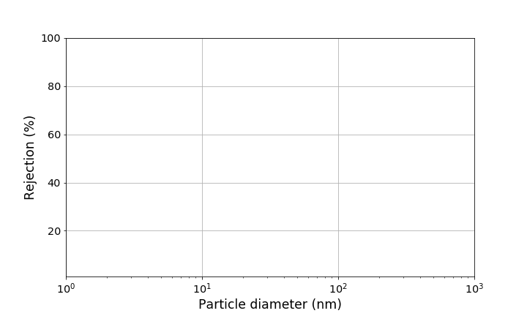
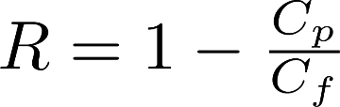
Definition of rejection for Membrane and Ultra Filtration
UF membrane retention rating
MF membrane retention rating

Slide 42
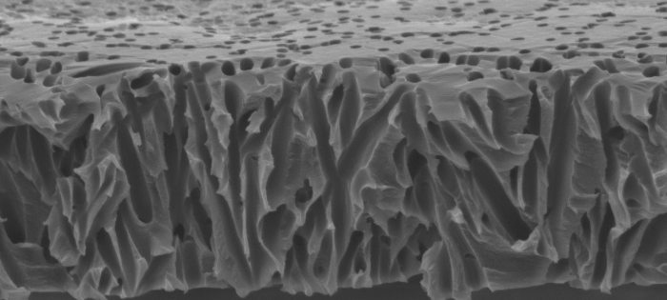
Proposed particle capture mechanisms
Colloidal matter adsorbed to wall of pores
Smaller particles trapped by previously strained particles
Particles strained at the surface
(presumed dominant mechanism)
Notes:
http://www.atl.semtechsolutions.com/node/18/membrane-filtration-technology

Slide 43

Membrane Hydraulics
Head loss through a clean membrane increases linearly with flow rate
Therefore minor losses must be insignificant!
Pores must be relatively long so that entrance and exit losses are insignificant
Hagen Poiseuille

Slide 44
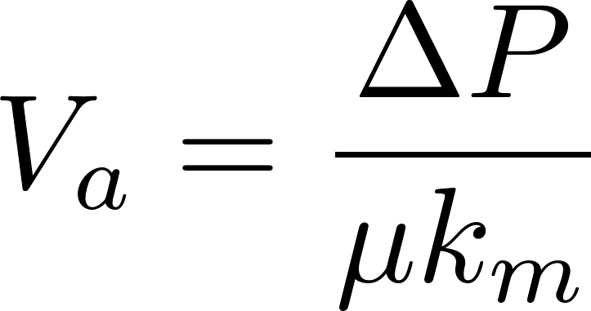
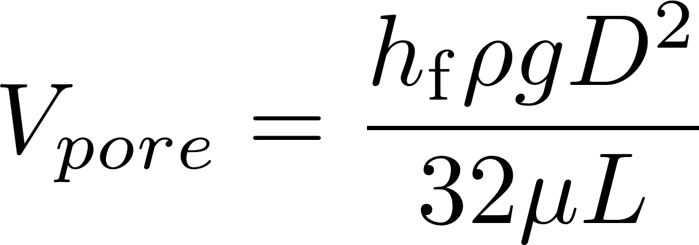
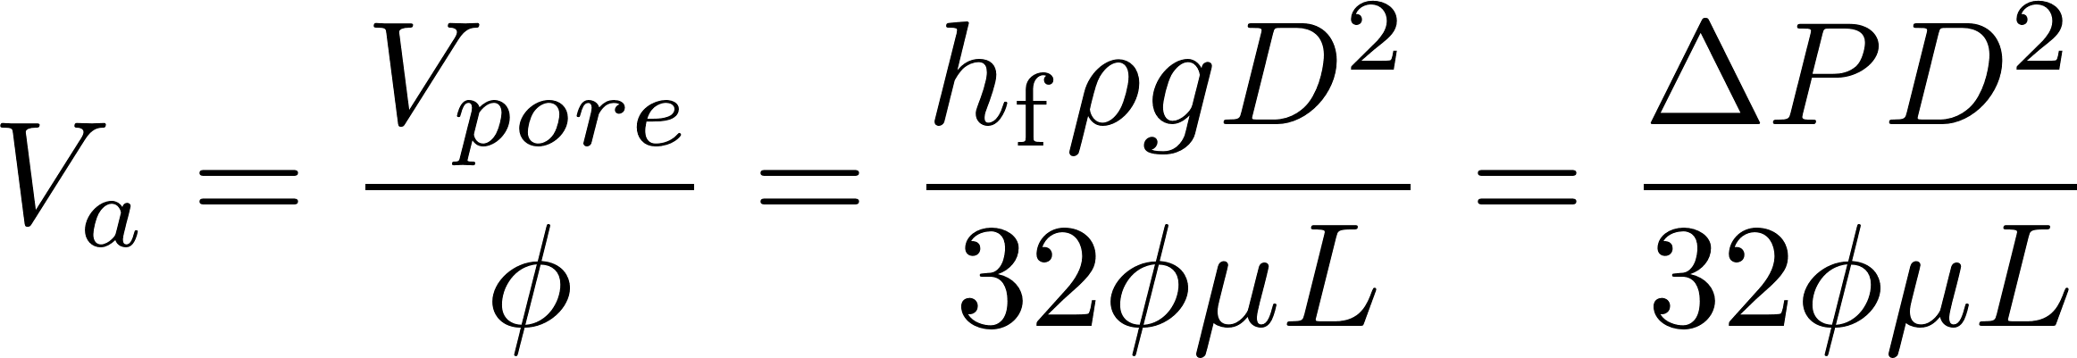
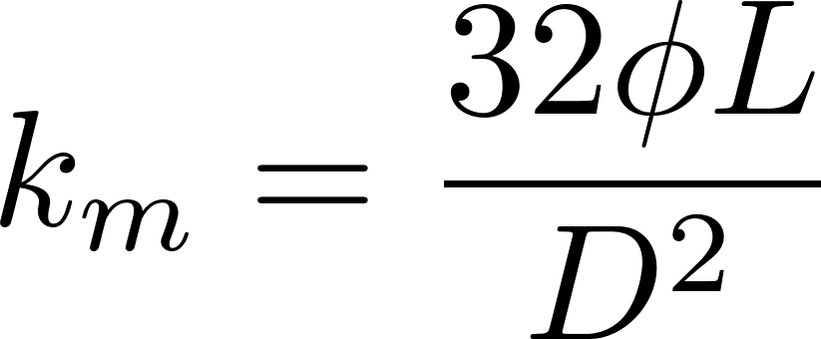
Head loss through membranes
Given that the pore diameter and length are poorly defined, a resistance coefficient is used
From Hagen Poiseuille
Comparing the two equations we see that

Slide 45
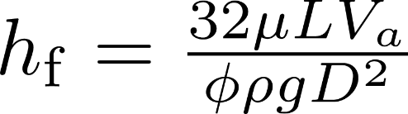
Head loss through membranes
100 nm pore diameter
Porosity of 0.15 (I can’t find any data!)
Pore length of 1000 x diameter (0.1 mm)
Approach velocity of 8 μm/s
Temperature of 15 C
Gives a head loss of 2 m (typical clean head loss)

Slide 46
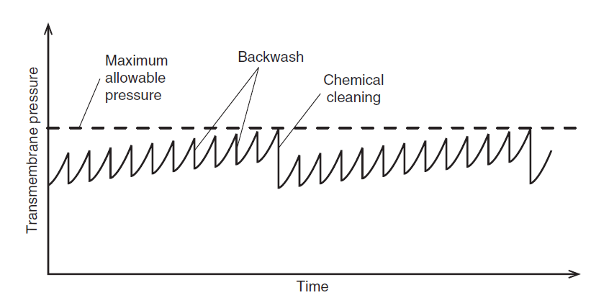
Head loss vs time for a membrane filter is nonlinear
From MWH Figure 12-5 on page 830.
Notes:
Suggests that pores are being plugged and so fewer and fewer pores are available.
100 pores. 1 particles removed 99 pores left.
80th particle removed 1/20 of the remaining pores are plugged. Remaining pores must carry all of the flow and thus pore velocity increases more and more rapidly as pores are clogged.

Slide 47
Membranes vs Slow Sand?
Approach velocity for membranes is 8 – 50 μm/s
Approach velocity for SSF is 12 cm/hr = 33 μm/s
Both slow sand and membranes form a filter cake on top of the filter
Both slow sand and membranes can operate without any coagulant
You can’t backwash SSF and you can’t wrap a SSF into a cartridge!
Membranes have more in common with SSF than with RSF!

Slide 48
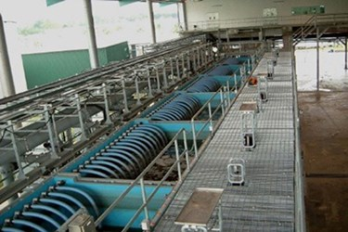
Example product: MEMCOR XS submerged membrane system
Treated capacity from 7.5 – 25 L/s
Compact footprint: 2.4 m x 4.4 m
Net velocity: 0.7 – 2.4 mm/s
This is the area required for the submerged membranes and thus can be compared to the granular filtration area
Requires more space than StaRS filters
Notes:
https://www.evoqua.com/en/brands/Memcor/Pages/memcor-xs.aspx

Slide 49
Floc/floc blanket/sed before membranes?
“If the raw water turbidity and/or NOM concentration is high, pretreatment will include coagulation, flocculation, and sedimentation.”
No indication of what “high” means
Pilot testing recommended
Note that the water industry doesn’t know how to design pilot tests for floc/sed systems that perform as well as full scale
“La prueba de jarra no tiene na que ver con como funciona una planta” – Antonio Elvir
Water and Wastewater Engineering: Design Principles and Practice. Mackenzie Davis

Slide 50
Membrane fouling
Reduction in flow due to accumulation of particles and adsorbed species
Can be reduced with chemical treatment
Another waste stream that requires management
Increases the required footprint of the treatment plant

Slide 51
Membrane cleaning
Backwash velocities are generally much higher than filtration velocities
Generally a high enough velocity to displace the cake in a single pulse is desirable
Total volume of backwash must be sufficient to move the particles far enough away from the membrane that they are not re-entrained when forward flow resumes
Chemicals are added to remove molecules that have entered the pores
Notes:
Backwash velocities are generally much higher than filtration velocities. The correct value is more of a black art than a science because it depends on how the particles adhere to each other and to the membrane as well as whether some fraction penetrates into the pores and how tortuous those pores are. It is generally impossible to remove particles that have entered the pore structure, but it is possible to move them sometimes and make them pack into a tighter, less porous, structure. Generally a high enough velocity to displace the cake in a single pulse is desirable. If not enough energy is used, the cake can crack but still remain attached to the membrane. The backwash preferentially flows through the cracks, leaving much of the cake behind. Another consideration is the total volume of backwash. It must be sufficient to move the particles far enough away from the membrane that they settle out and are not re-entrained when forward flow resumes. Mark Hurwitz

Slide 52

Membrane Story: Temple Texas
Expect to treat 15 MGD (2004)
Membranes from Pall Corporation
No pretreatment
$14,800,000
Reduced flow after 1st year 11.6 MGD
2008 upgrade
New chemical clean in place system $590,524
Flocculation/Sedimentation $2,607,785
Total cost – $35,263 per L/s of capacity
2017 capacity reduced to 6 mgd
Notes:
$14,800,000
https://www.kpaengineers.com/portfolio-items/membrane-filtration-plant/
15 MGD
No pretreatment
$22500 /(L/s)
Actuually operates at 11.6 MGD
Project Description: The City of Temple, Texas owns and operates the 11.6 MGD Membrane Water Treatment Plant. The plant was placed into operation in 2004 and operated as originally designed for the first 12 to 15 months. However, over the past several years the plant has not been able to consistently operate at the design capacity. $590,524 to upgrade the chemical cleaning
Realized they needed pretreatment in 2008
Flocculation/Sedimentation $2,607,785
2017 down to 6 mgd
http://www.tdtnews.com/news/article_679b5530-a629-11e7-8d69-0ff68a1a883c.html
See https://moralescompany.com/completed-projects/water-treatment-plants for lots of photos

Slide 53
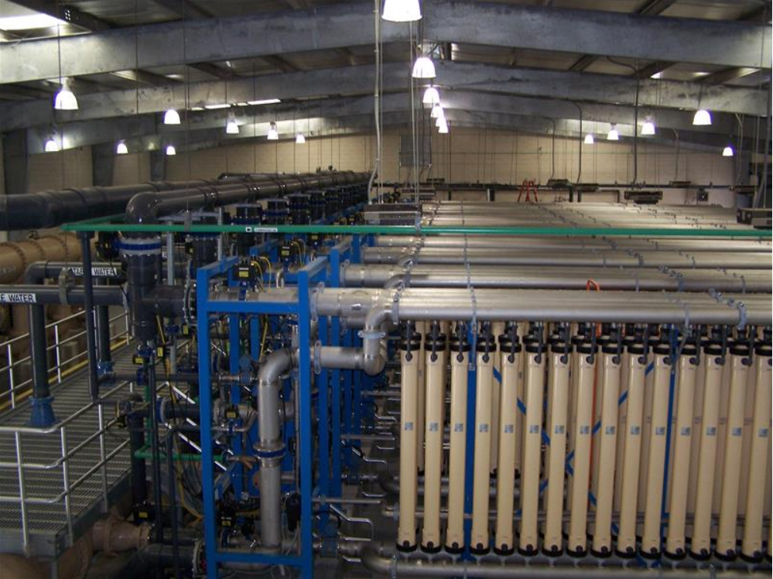
Notes:
See https://moralescompany.com/completed-projects/water-treatment-plants for lots of photos

Slide 54
What’s missing
What solids concentration can membrane filters handle?
How do coagulant nanoparticles interact with membrane filters?
What is the mechanism responsible for head loss build up?
How do membranes handle dissolved organic matter?

Slide 55
Assignment on unit process selection
Goal is to create better tools
What are the dream characteristics of this tool?
What do you want this tool to do?
Notes:
Given contaminant
Find MCLG from EPA
Try various possible unit processes (based on EPA database or other source)
Calculate operating and capital costs of each UP
Pick the most economical option that meets the treatment goal

Slide 56
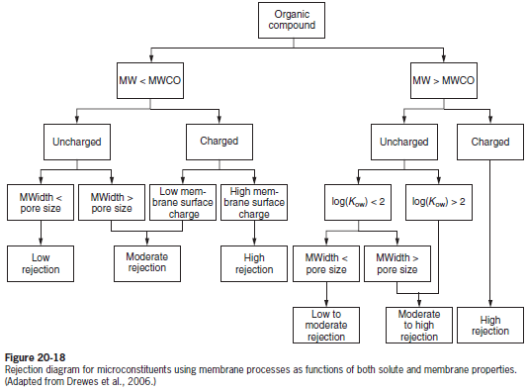
Part of a model for removal of dissolved species with membranes
MWH’s Water Treatment

